Slide 1
Gesture Based UI Project
By Ryan Conway and Brian Doyle

Slide 2
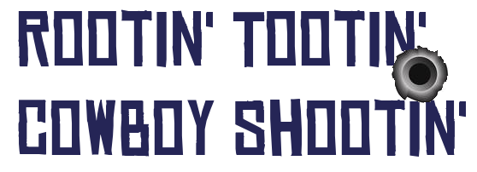
First Person Shooter.
Shooting gallery where the user shoots objects in the scene.
When the user shoots all the object they advance to the next level

Slide 3
Initial Ideas
Monkey Ball style ball roller
Mini Golf
Shooting range
360 Degree environment
Static and moving targets
Wild West theme

Slide 4
Myo
Motion/Gesture Controller
Can read a persons arm movements and hand gestures.
Working with Unity – Armband as the controller.

Slide 5
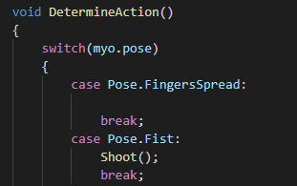
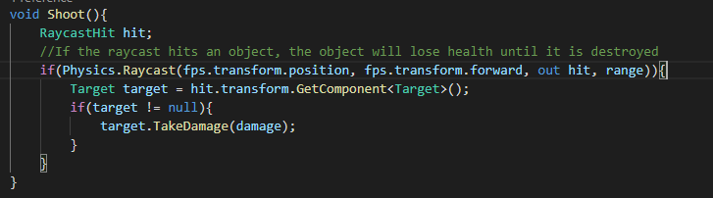
Code Example
We first determine the gesture currently active
And call a corresponding method e.g. Shoot()

Slide 6
Development
Started with setting up the scene with blank objects.
Worked on that and what mechanics to implement.
Get the movement and shooting working with mouse + keyboard
Transitioned to Myo controls once working.

Slide 7
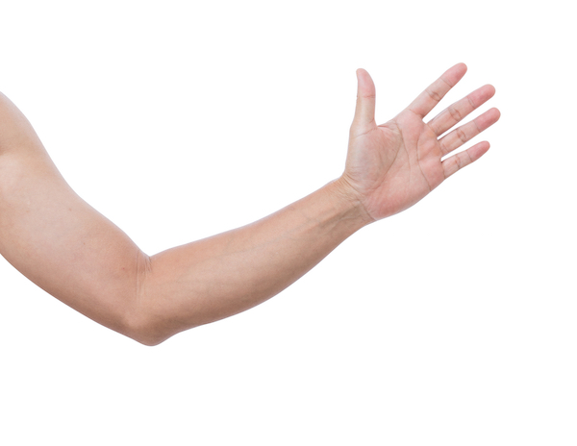
Gestures
Camera is controlled by moving your arm.

Slide 8

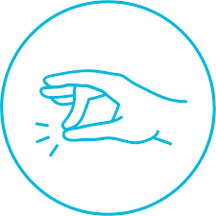
Gestures
Fist to Shoot Tap Finger to Recalibrate

Slide 9
Why These Gestures?
We decided on the arm movement gesture for aiming as it made the most sense.
Tap fingers for recalibration – easy gesture
Fist for shooting – closest gesture to pulling a trigger

Slide 10
More Gestures
Plan to use more gestures - Main Menu, Pause Menu.
Gestures undecided as of yet.
Each option on screen can be pressed using a different gesture
E.g. Wave Out -> Start Game, Wave In -> Options

